Slide 1
Entity Relationship (E/R) Data Model
  Introduction to Database Systems
  Chapter 4
  Carlos Coronel, Steven Morris - Database Systems: Design, Implementation & Management, 13th edition, CENGAGE Learning, 2019, ISBN-13: 978-1337627900.
Database Systems
Robert Dollinger 2021

Slide 2
Entity Relationship (E/R) Data Model
Objective:
Introduce the Entity Relationship (E/R) Data Model.
Main topics:
- What is the Entity Relationship (E/R) Data Model?
- Entities, Relationships;
- Characterization of relationships: arity and functionality;
- Entity Relationship (E/R) Data Model Notation (Syntax);
- Entity Relationship (E/R) Diagrams.
Database Systems
Robert Dollinger 2021

Slide 3
Entity Relationship (E/R) Data Model
What is the Entity Relationship (E/R) Data Model?
The E/R Data Model proposed in 1970 by Dr. Peter Chen is:
  a set of graphical symbols one can use to describe collections of data;
  a tool for design and documentation for a database structure;
  used to create conceptual models or database schemas in a manner that is independent of any database system;
  the pseudocode for database schema design, similar to the Unified Modeling Language (UML) used in OO Design;
  considered a semantic data model that provides representations at a high level of abstraction.
Database Systems
Robert Dollinger 2021

Slide 4
Entity Relationship (E/R) Data Model
Entities, Relationships
Entity – is anything in real world that is distinguishable from the surrounding environment.
Entities are highly abstract and can represent concepts and objects.
Relationships – describe how entities relate to each other.
Entities and relationships can have attributes describing their properties.
Some attributes may be marked (underlined) as keys that can uniquely identify instances of the entity.
Database Systems
Robert Dollinger 2021

Slide 5
Entity Relationship (E/R) Data Model
Examples:
1. Entities:
Employee(Last Name, First Name, SSN, Birth_Date, Address, Qualification)
Department(Department Name, Company Name, Address, #Employees)
Relationships connecting entities Employee and Department:
Works_In(Since, As)
Manages(Since)
2. Entities:
Employee(EID, Name, Address, Birth_Date, Salary)
Employee_Phone(EID, Phone#, Minutes_Used)
Database Systems
Robert Dollinger 2021

Slide 6
Entity Relationship (E/R) Data Model
  Characterization of relationships
  Two aspects of relationships are of interest for database modeling:
  Relationship Arity (or degree) – is number of entity types participating in the relationship.
  Relationship Functionality - how entity instances connect to each other. An entity instance my connect to only one or to many instances of another entity.
Database Systems
Robert Dollinger 2021

Slide 7
Entity Relationship (E/R) Data Model
Relationship arity/degree
One can have:
binary – relating two entities; like;
        instructor-student;
        student-classroom;
        student-class;
        instructor-classroom;
        student-discipline;
        instructor-discipline.
ternary – relating 3 entities; like:
instructor-student-classroom;
instructor-student-discipline.
…
n-ary relationships – relating n entities.
Database Systems
Robert Dollinger 2021

Slide 8
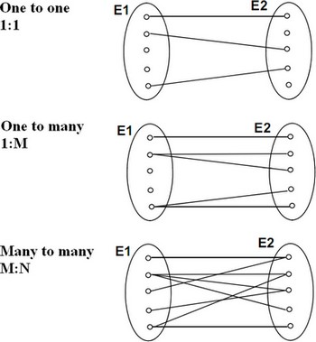
Entity Relationship (E/R) Data Model
Relationship Functionality – Binary Case
Types of binary relationships between entity types (sets of entity instances):
  one-to-one (1:1) – two ways functional, each entity of the E1 type connects to at most one entity of the E2 type, and the other way around;
  one-to-many (1:M) – one way functional, one entity of the E1 type may connect to several entities of the E2 type, but each entity of E2 connects to at most one entity of E1; the relationship is said to be functional towards E1 because instances of E1 are a function of instances of E2;
  many-to-many (M:N) – nonfunctional, any entity of the E1 type may connect to any number of entities of the E2 type, and the other way around.
Database Systems
Robert Dollinger 2021

Slide 9
Entity Relationship (E/R) Data Model
Examples:
  1) The Works_In relationship between entity types Employee and Department, is a one-to-many relationship, since an employee works in one single department, while a department has several employees.
  Characterization:
  It’s one way functional;
  Is functional with respect to entity Department;
  Department instance is uniquely determined by Employee instance;
  For a given employee there is one single possible department.
  2) Manages is a one-to-one relationship. Why?
  Characterize!
Database Systems
Robert Dollinger 2021

Slide 10
Entity Relationship (E/R) Data Model
Relationship Functionality – Higher Degree Case
When more than two entities are involved, the functionality of the relationship is relative to each of the entities participating in the relationship.
The same relationship can be functional with respect to one entity while it is non-functional with respect to another entity.
Definition:
A relationship R is functional with respect to an entity E if and only if every instance of entity E is uniquely determined by some instances of the other entities participating into the relationship.
That is, if we can name the instance of E by knowing one instance from all or some of the other entities in the relationship R then the relationship is functional with respect to E.
Definition:
A relationship R is functional with respect to an entity E if and only if every instance of entity E is uniquely determined by some instances of the other entities participating into the relationship.
Database Systems
Robert Dollinger 2021

Slide 11
Entity Relationship (E/R) Data Model
Examples:
1) instructor-student-classroom – as in instructor lectures student in classroom,
is not functional with respect to student.
Really, in a class there should be more than one student.
2) instructor-class-classroom-time – as in instructor lectures student in classroom at a given time is functional with respect to:
instructor,
class,
classroom,
but is not functional with respect to time.
Please check this out!
Database Systems
Robert Dollinger 2021

Slide 12
Entity Relationship (E/R) Data Model
Entity Relationship Graphical Symbols
Strong Entity | Strong entities are independent from other entities, and are often called parent entities,
Weak Entity | Weak entities depend on some other entity type.
Relationship | Relationships are associations between or among entities.
Weak Relationship | Weak Relationships are connections between a weak entity and its parent.
Attribute | Attributes are characteristics of an entity, a relationship.
Key Attribute | Attributes that are part of a primary key identifying an entity.
Employee
Employee_Phone
Works_In
Has_Phone
Address
EID
Database Systems
Robert Dollinger 2021

Slide 13
Entity Relationship (E/R) Data Model
Entity Relationship Graphical Symbols – Special Cases
Functional Relationship | Relationship is functional towards entity.
Non-Functional Relationship | Relationship is not functional towards entity.
Type to sub-type connection | Entity type is a sub-type of another entity type.
Employee
Manager
Database Systems
Robert Dollinger 2021

Slide 14
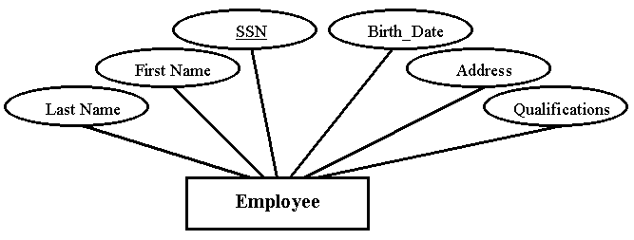
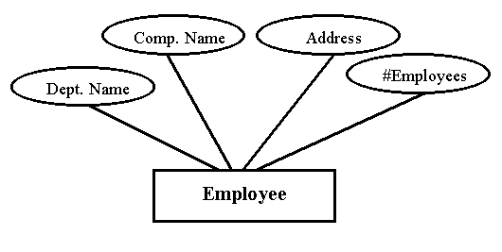

Entity Relationship (E/R) Data Model
  Entity Relationship E/R Diagrams - Entity representations
1) Employee(Last Name, First Name, SSN, Birth_Date, Address, Qualification)
2) Department(Department Name, Company Name, Address, #Employees)
Database Systems
Robert Dollinger 2021

Slide 15
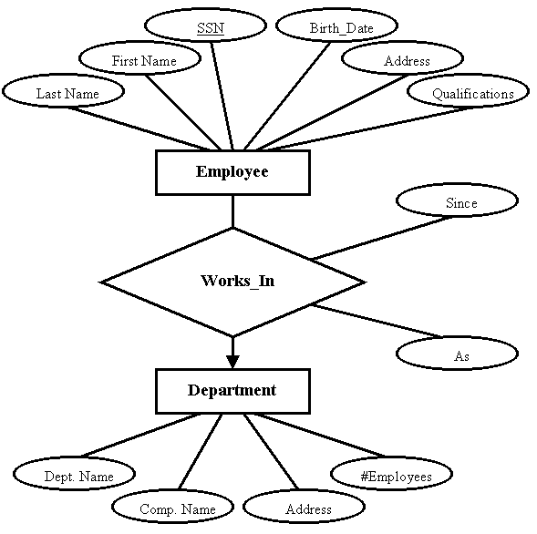
Entity Relationship (E/R) Data Model
  Entity Relationship E/R Diagrams - Relationship representations
Works_In relationship between entity types Employee and Department
Works_In is a one-to-many relationship, since an employee works in one single department, while a department has several employees.
Functionality is towards Department as arrow shows, because if we know the employee then we know department she works in.
Database Systems
Robert Dollinger 2021

Slide 16
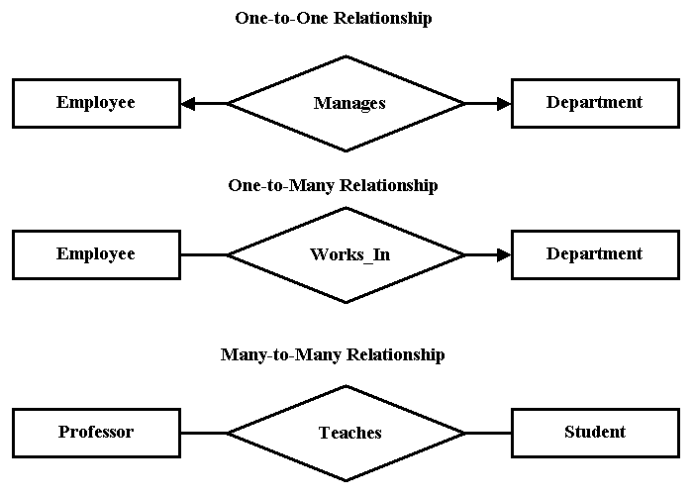
Entity Relationship (E/R) Data Model
  Representing Functionality of Binary Relationships
Database Systems
Robert Dollinger 2021

Slide 17
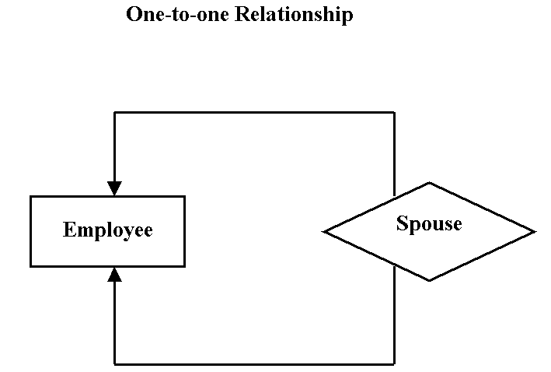
Entity Relationship (E/R) Data Model
  Self Referencing Entity Type
Database Systems
Robert Dollinger 2021

Slide 18
Entity Relationship (E/R) Data Model
  Entity Relationship E/R Diagrams – Weak Entity and Relationship
  Employee(EID, Name, Address, Birth_Date, Salary)
Employee_Phone(EID, Phone#, Minutes_Used)
Employee is a strong entity (it can exist on its own).
Employee_Phone is a weak entity dependent on Employee.
Has_Phone is the weak relationship connecting Employee_Phone to Employee.
It is a one-to-many relationship because an employee can have multiple phone numbers.
The relationship is functional towards Employee.
Employee
Has_Phone
Employee_Phone
Database Systems
Robert Dollinger 2021

Slide 19
Entity Relationship (E/R) Data Model
  Entity Relationship E/R Diagrams – Weak Entity and Relationship
  Course(Course#, Name, Description, #Credits)
Course_Section(Course#, Section#, Year, Term, Enrollment)
Course_Section is a weak entity dependent on the strong entity Course.
The key uniquely identifying Course_Section instances is composed of the course key, Course# and the attribute representing the section number within the course, Section#.
Belongs_To is the weak one-to-many relationship connecting Course_Section to Course.
The relationship is functional towards Course.
Course
Belongs_To
Course_Section
Database Systems
Robert Dollinger 2021

Slide 20
Entity Relationship (E/R) Data Model
  Entity Relationship E/R Diagrams – Ternary Relationship
Uses is a ternary relationship, described as employee sues skill on project, and is non-functional towards all connected entity types.
Project - An employee can use a skill on multiple projects.
Skill - An employee can use multiple skills on the same project.
Employee - A project may use the same skill from multiple employees.
Skill
Uses
Project
Employee
Database Systems
Robert Dollinger 2021

Slide 21
Entity Relationship (E/R) Data Model
  Entity Relationship E/R Diagrams – Ternary Relationship
Works is a ternary relationship, described as teacher works on graduation project with student.
The relationship is functional towards:
Grad_Project – A teacher works with given student on one single graduation project.
Teacher – A student on graduation project with one single teacher.
Works is non-functional towards:
Student - A teacher can have a project with many students working on it.
Teacher
Work
Grad_Project
Student
Database Systems
Robert Dollinger 2021

Slide 22
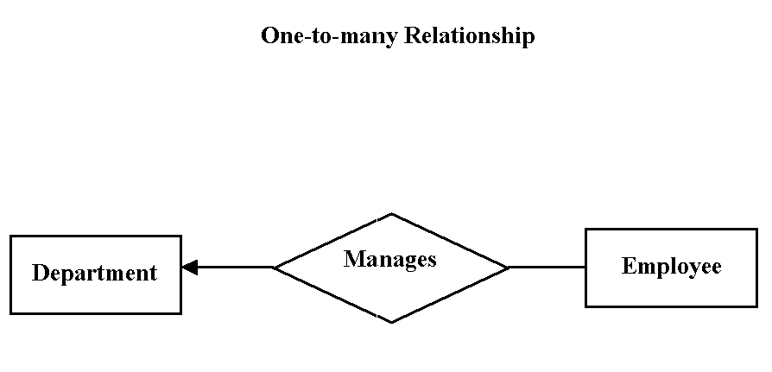
Explain/Read Diagram
Entity Relationship (E/R) Data Model
Multiple employees collectively manage department.
Database Systems
Robert Dollinger 2021

Slide 23
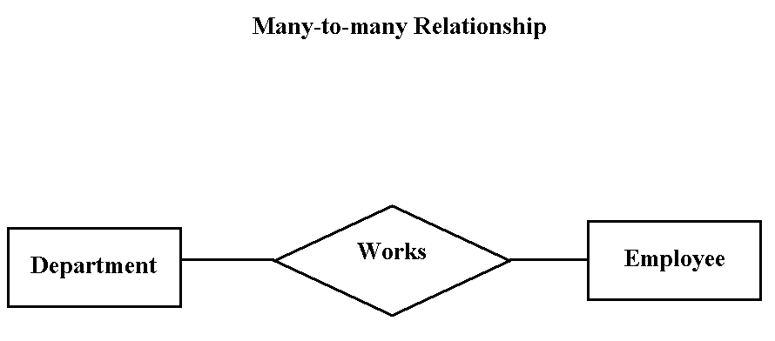
Explain/Read Diagram
Employees can have multiple job.

Slide 24
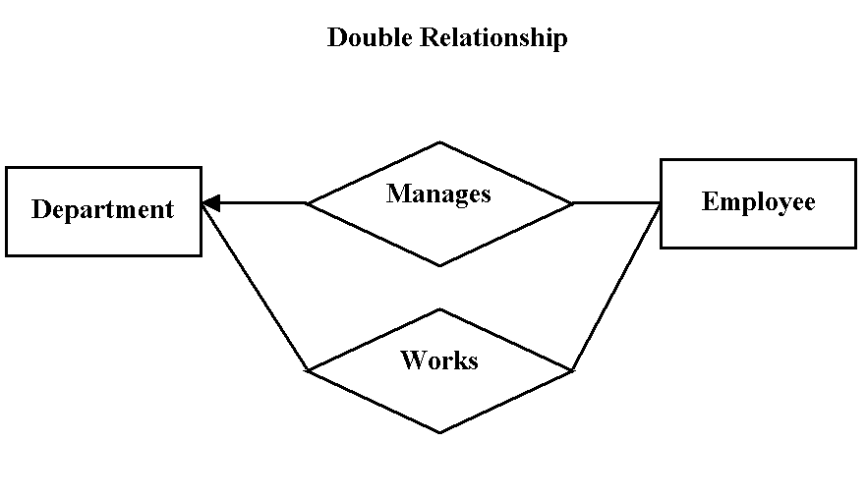
Explain/Read Diagram
Employees can have multiple jobs, but can be managers in one single place.

Slide 25
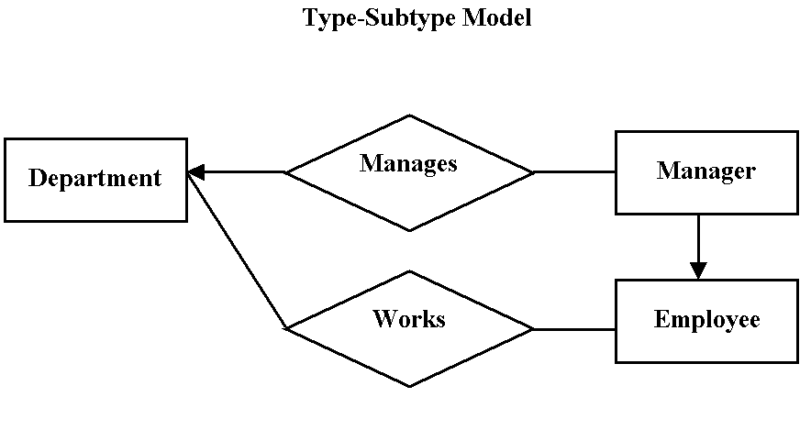
Explain/Read Diagram
Employees can have multiple jobs. Managers are special kind of employees (sub-type). Managers can manage one single place.

Slide 26
Entity Relationship (E/R) Data Model
E/R Challenge
Use the following business rules to establish the right relationship functionalities in the ER diagram on the next slide:
  A department employs many employees, but each employee is employed by only one department.
  A division operates many departments, but each department is operated by only one division.
  An employee may be assigned to many projects, and a project may have many employees working on it.
  A department may be managed by several employees, working in that department.
  One of the employees runs each division, and each division is run by only one employee.
Database Systems
Robert Dollinger 2021

Slide 27
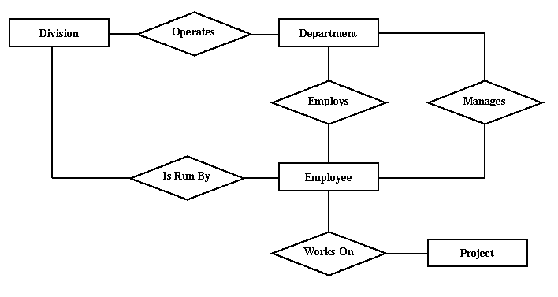
Entity Relationship (E/R) Data Model
Database Systems
Robert Dollinger 2021

Slide 28
?
?
?
?
?
?
?
?
?
?
?
?
?
?
Database Systems
Robert Dollinger 2021

